Slide 1
COMPUTER VISION PROJECT
End Sem-Evaluation
Abhishek Sharma
Rishabh malik
Piyush Atri
Devansh Dobriyal
(RC-SQUAD)

Slide 2
PAPER IMPLEMENTATION
“Dual Illumination Estimation
for
Robust Exposure Correction”
By - Qing Zhang, Yongwei Nie, and Wei-Shi Zheng

Slide 3
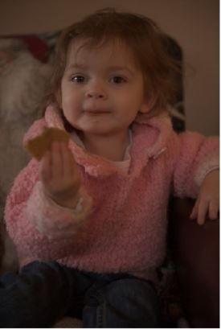
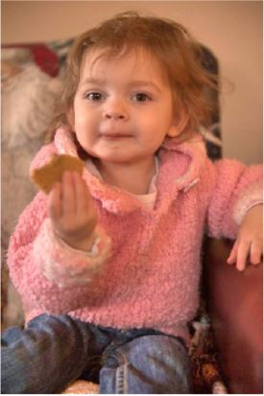
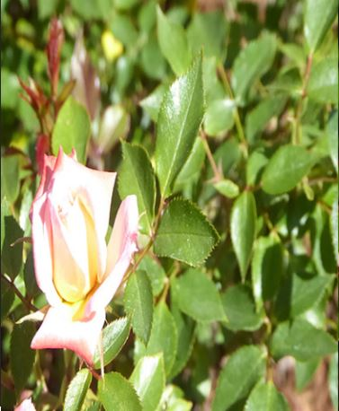
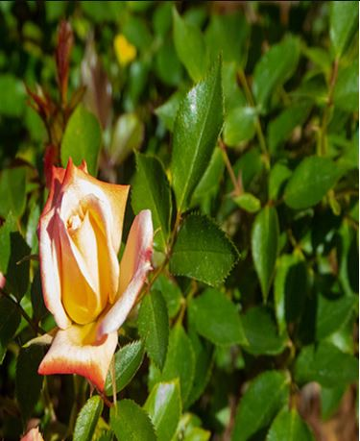
OBJECTIVE
To make an automatic exposure correction method.
Fixes both under-exposed and over-exposed images.

Slide 4
METHOD OVERVIEW
We are going to implement this paper by dividing the whole process into 4 parts:
Correcting the under-exposed input image using forward illumination method.
Correcting the over-exposed input image using reverse illumination method.
Fusing these 2 intermediate correct exposure image(mentioned above) with the input image to extract the best exposed parts.
Combining these best exposed parts to get final well-exposed output image.

Slide 5
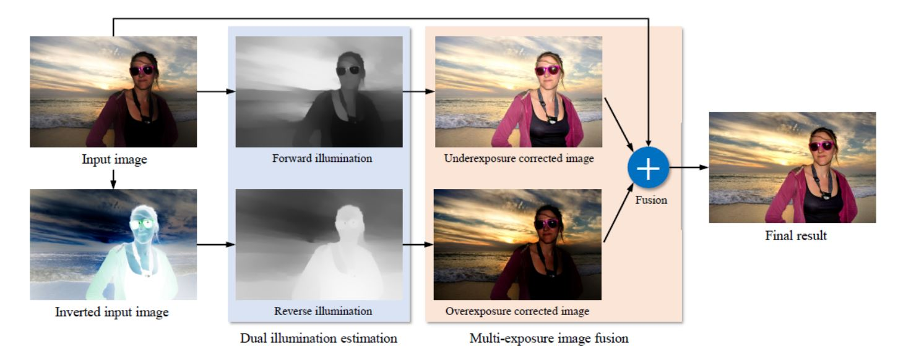
METHOD OVERVIEW

Slide 6
FORWARD ILLUMINATION METHOD
Assumption: Image I (normalized to [0,1]) can be characterized as a pixel-wise product of the desired enhanced image I’ and a single-channel illumination map L:
I = I’ x L -> Eq1
Where x denotes pixel-wise multiplication.
So we can extract the best exposed parts of the under-exposed image.

Slide 7
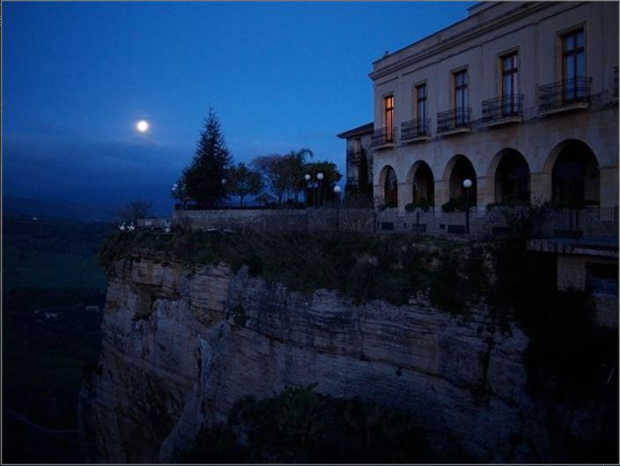
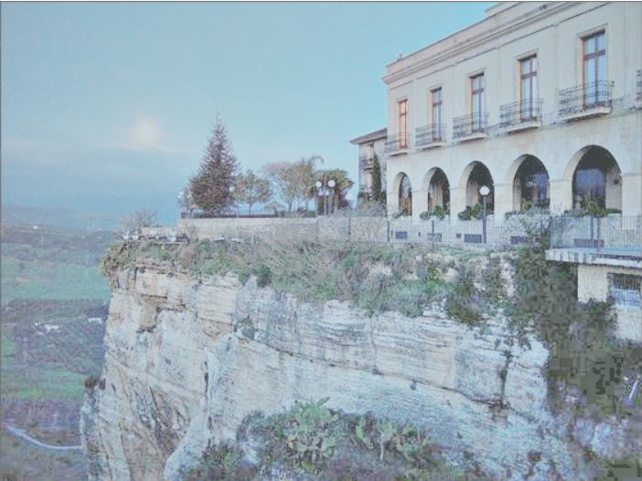
FORWARD ILLUMINATION METHOD
RESULTS

Slide 8

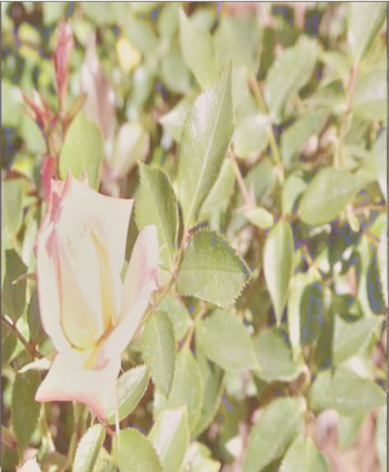
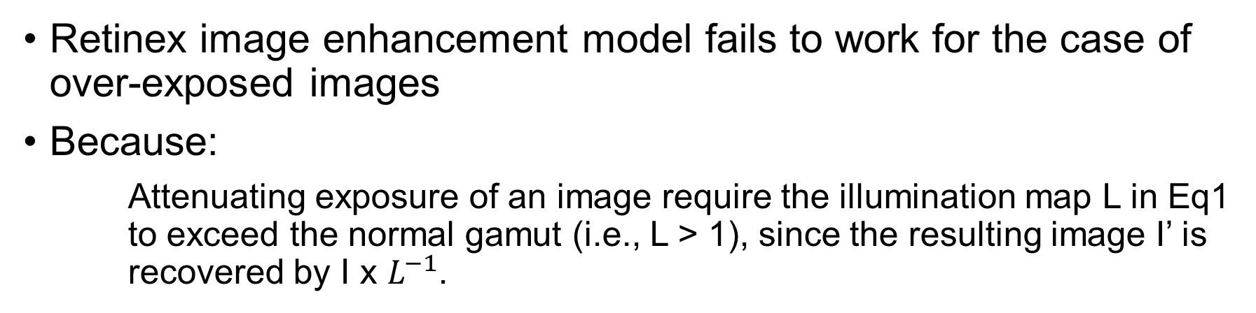
reverse ILLUMINATION METHOD
Retinex image enhancement model fails to work for the case of over-exposed images
Because:
Attenuating exposure of an image require the illumination map L in Eq1 to exceed the normal gamut (i.e., L > 1), since the resulting image I’ is recovered by I x $L^{−1}$.

Slide 9
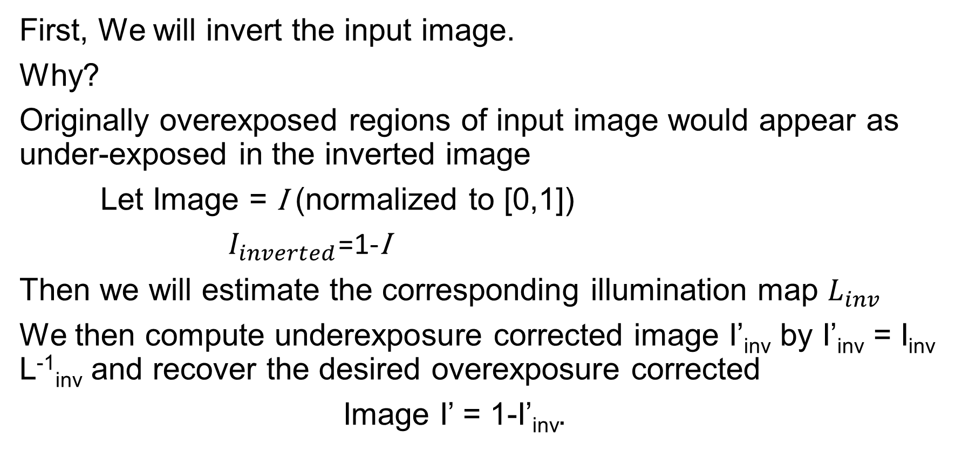
Approach for over exposed images
First, We will invert the input image.
Why?
Originally overexposed regions of input image would appear as under-exposed in the inverted image
Let Image = I (normalized to [0,1])
$I_{inverted}$=1-I
Then we will estimate the corresponding illumination map $L_{inv}$
We then compute underexposure corrected image I’_{inv} by I’_{inv} = I_{inv} L⁻¹_{inv} and recover the desired overexposure corrected
Image I’ = 1-I’_{inv}.

Slide 10
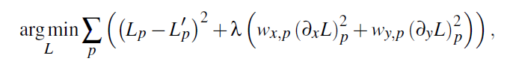
Calculating Illumination map
Estimating a refined illumination map L from L0 by preserving the prominent structure, while removing the redundant texture details. Objective function for obtaining the desired illumination map

Slide 11
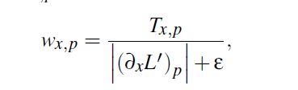
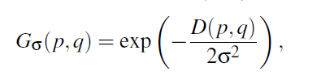
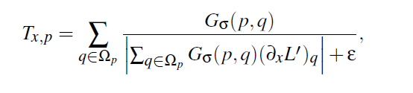
Calculating smoothness weights
Smoothness weight W xp is written as
Gs(p,q) computes the spatial affinity based Gaussian weight between pixels p and q, and sigma = 3 is the standard deviation.
T xp is the relative total variation (RTV) defined as
The function D(p,q) computes the spatial Euclidean distance between pixels p and q.

Slide 12
Gamma parameter
The Gamma adjustment is applied to the illuminations produced by each method when recovering the exposure correction result
So our illumination map is modified as:
L = L^(gamma)

Slide 13
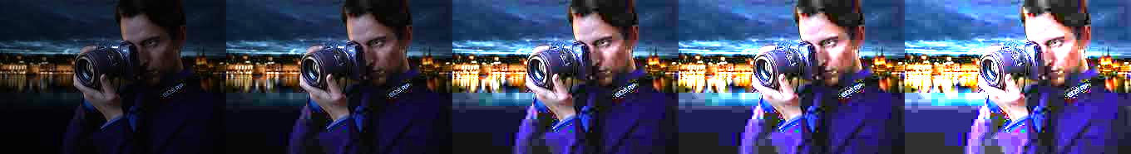
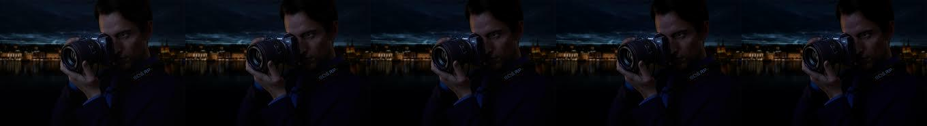
Varying gamma
Varying gamma from left to right with values 0.2, 0.4, 0.6, 0.7, 0.8
Forward illumination
Backward illumination

Slide 14
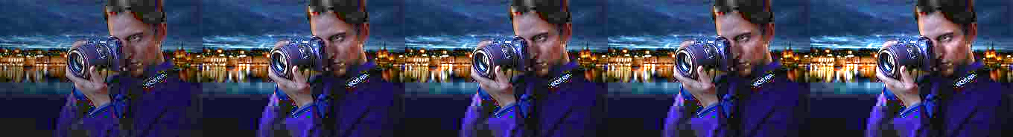
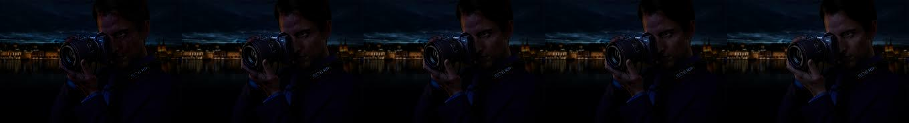
Varying lambda (smoothness coefficient)
Varying lambda from left to right with values 0.01, 0.1, 0.15, 0.2, 0.5
Forward illumination
Backward illumination

Slide 15


Contrast enhancement using histogram Equalization
Applying contrast enhancement on an image :-
Original Image Enhanced Image

Slide 16
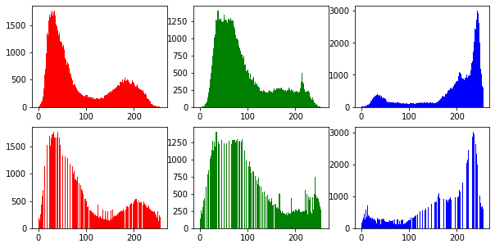
Visualization of Histogram equalization in each channel
Original Image
Enhanced Image

Slide 17
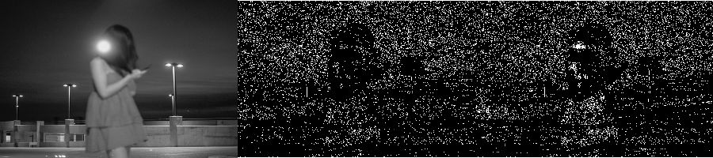
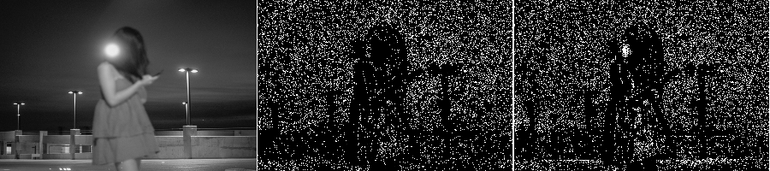
We can extract finer details from Enhanced image -
Original Image
Enhanced Image

Slide 18
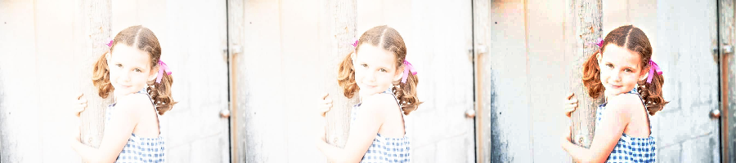
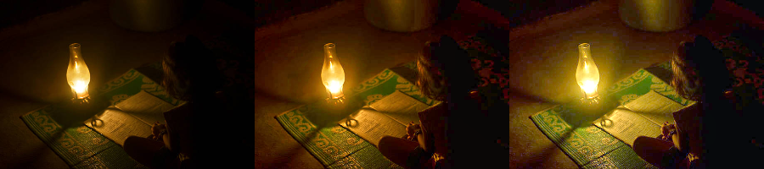
Output Image after Using Contrast Enhanced image for Merging
Output Image after Using original image for Merging
Original Image

Slide 19
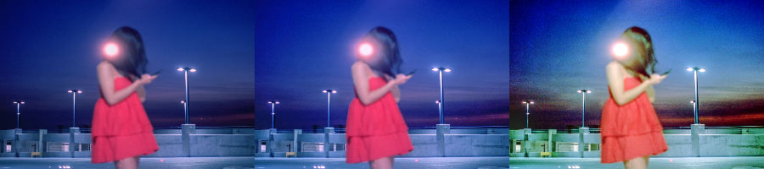
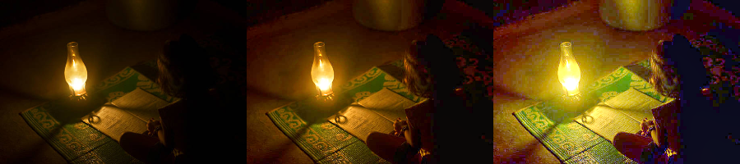
Observations when using enhanced image during dual illumination phase
Output Image after using Enhanced Image in Dual Illumination Phase
Output Image after using original image in merging process
Original Image

Slide 21
THANK YOU

